Slide 1

Z-Wave Overview
2020

Slide 2

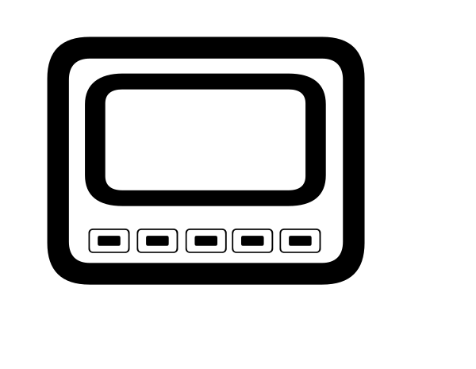




16°C
Gateway
Z-Wave Home

Slide 3
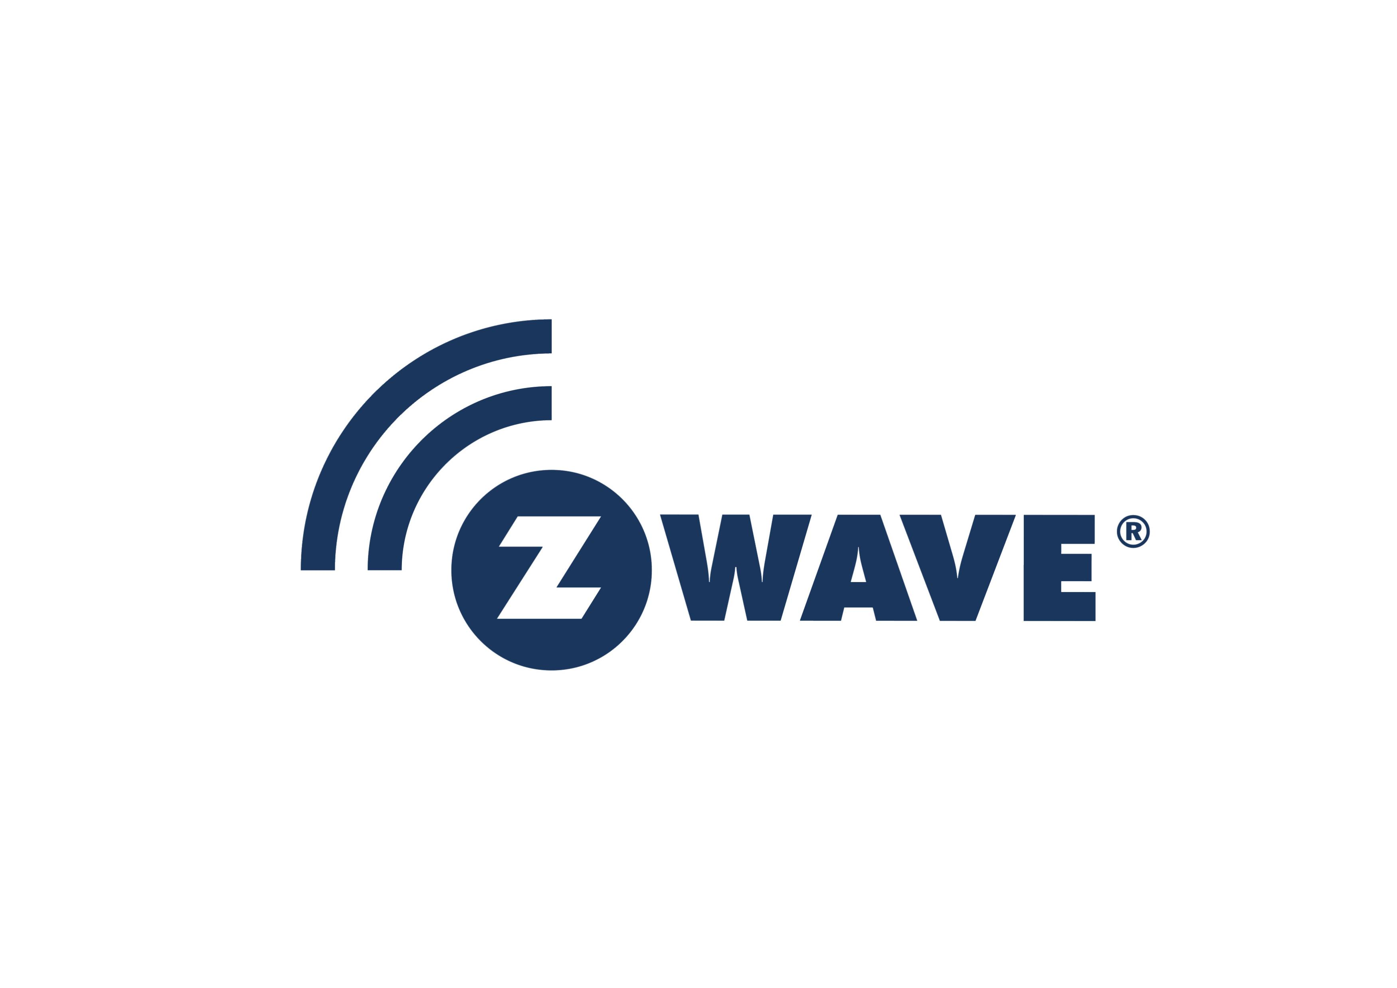
What’s Z-Wave
Z-Wave is a wireless communications protocol used primarily for home automation.
Mesh, Low energy, Low rate, Short range
Home Automation
allowing for wireless control of residential appliances and other devices, such as lighting control, security systems, thermostats, windows, locks.
Z-Wave provides the application layer interoperability between home control systems of different manufacturers that are a part of its alliance.
Interoperability

Slide 4
Z-Wave PHY
Z-Wave Global Regions
Sub GHz, license free ISM bands, region/Country specific
Data rate \ region frequency & channel(s) | US / Canada / South America | EU / UAE / China / India | AU / NZ / Brazil | Japan / Taiwan / Korea / Singapore
9.6kbps FSK Modulation | 908 MHz Ch 1 | 868 MHz Ch 1 | 921 MHz Ch 1 | NA
40kpbs FSK Modulation | 908 MHz Ch 1 | 868 MHz Ch 1 | 921 MHz Ch 1 | NA
100kpbs GFSK Modulation | 916 MHZ Ch 2 | 869 MHz Ch 2 | 919 MHz Ch 2 | 919-926 MHz Ch 1 - 3
https://www.silabs.com/products/wireless/mesh-networking/z-wave/benefits/technology/global-regions

Slide 5





Singlecast Example
Singlecast
Frame Types
Singlecast frames
Transmission from a Node to another Node
Transfer Acknowledge is sent as reply
Multicast frames
Broadcast frames
Acknowledgment
(if Transfer w/ ACK)

Slide 6

Z-Wave Device Archetypes
·
Notes:
z-wave网络定义了两种设备原型。controller和slave
或者叫end device

Slide 7
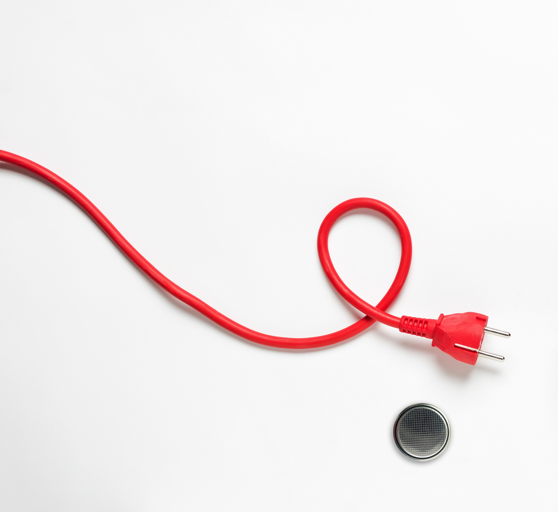
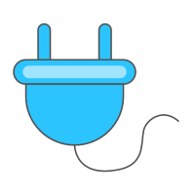

Z-wave Device Role types
Mains powered
Always On Slave [AOS]
Battery powered
Reporting Sleeping Slave [RSS]
Listening Sleeping Slave [LSS]

Slide 8


Always On Slave [AOS]
Always ON devices
Must be mains powered
Always reachable
Can receive and send commands at all times
The back-bone of the Z-Wave mesh
Is a repeater in the network

Slide 9
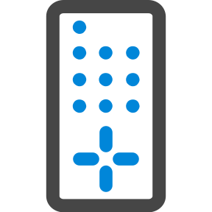

Z-Wave Route Rule
Explorer Frames
Explorer Frames
Special class of the broadcast frame that enables dynamic routing
It is used to discover/rediscover routes
Application command is included in the explorer frame
Explorer Frame Response
Explorer response uses source routing
Becomes the LWR when received
Limitation
4 seconds timeout
Only be sent to always on devices
Limits the maximum payload
Explorer frame
Search result frame

Slide 10
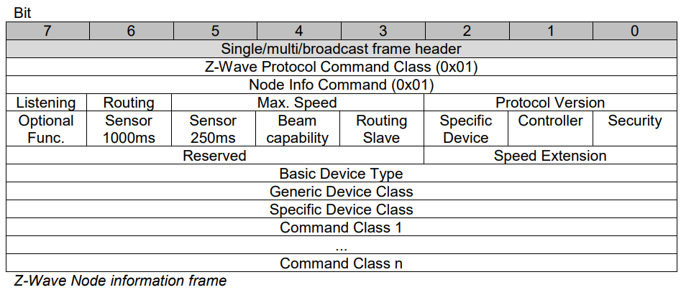
Z-Wave Device Inclusion/Exclusion
The Node Information Frame [NIF]
The business card of the Z-Wave node
Announces protocol and Application level capabilities
Network capabilities of the device
Device Classes implemented
List of Command Classes supported
Optionally - List of Command Classes controlled

Slide 11


Interoperability & Command class
More Importantly, Interoperability is Required
Required
Interoperability is required of all Z-Wave devices.
For the device to achieve Z-Wave interoperability the product must pass the Z-Wave Certification program
Only certified Z-Wave devices may carry the Z-Wave or Z-Wave Plus logo.
There are no proprietary implementation or closed ecosystems / walled-gardens with Z-Wave. All devices must coexist and allow usage of the device or devices regardless of make, model, or manufacturer.
Z-Wave Certification
Z-Wave logo
Coexist

Slide 12
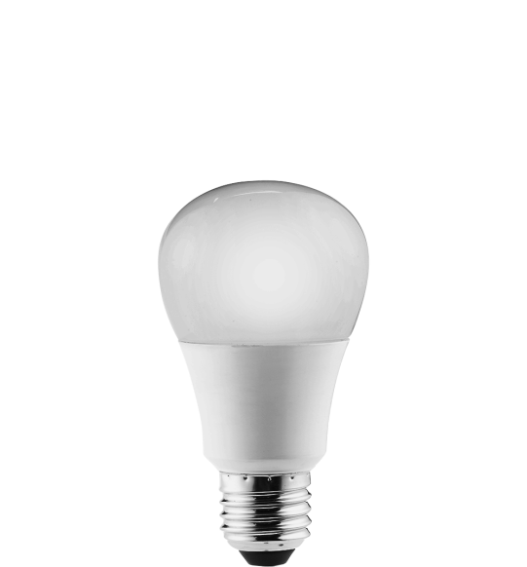
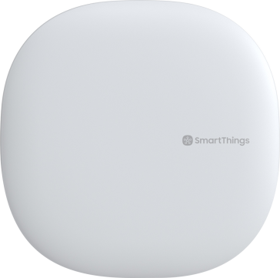
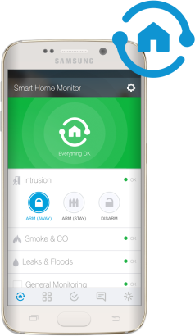
Interoperability & Command class
The device is well described:
Role Device Class
Defines the role in the network.
Device Classes
Describes the type and functionality of a device.
Command classes
The grammar for the Z-Wave language.
How does Z-Wave ensure Interoperability?
Welcome to the network.
I’m a Controller.
I’m an Always-On-Slave

Slide 13
